Slide 1
The Problem of Power
Rafael Marques

Slide 2
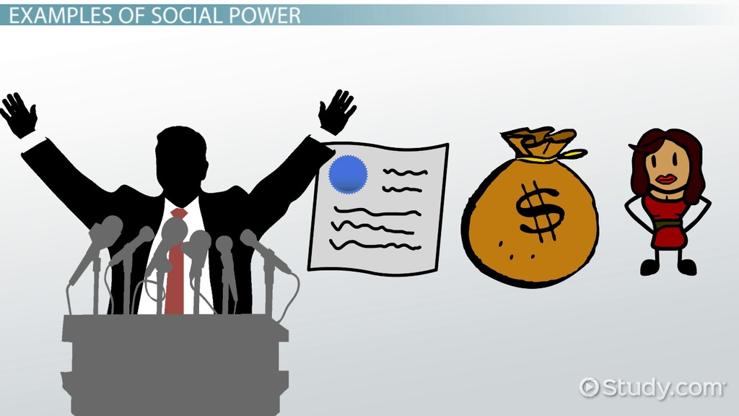
Definitions and Sources

Slide 4
Power as a Social Phenomenon
Asymmetrical, Changeable, Reversible, and Unstable.
A B Moment t
B A Moment t+1

Slide 5
Power as a Social Phenomenon
Non-Transitive
A B C
A C

Slide 6
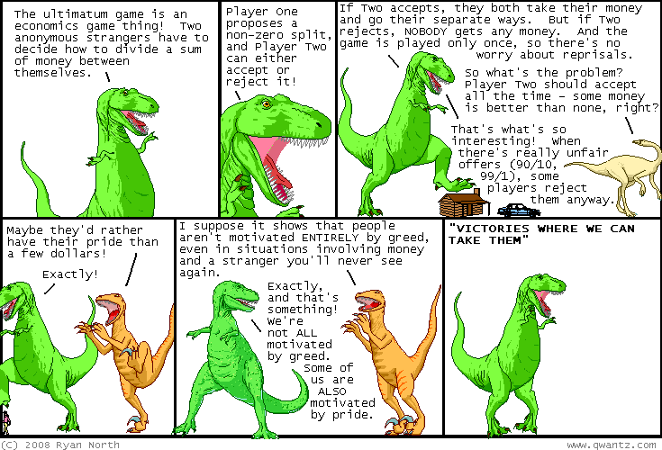
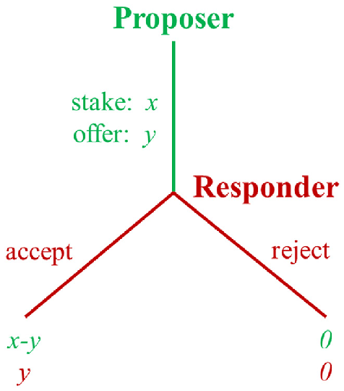
Power as a Social Phenomenon
Reciprocal and Established as a Relation

Slide 7
Dictator, Ultimatum, and Trust Games

Slide 8
Four Experimental Games

Slide 9
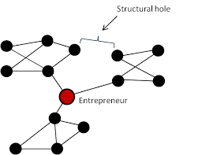
Power in Networks
Knowing Something Central and Difficult to Find.
(Unique Skills or Competences).
Marginal Secants, Bridges, Filters, and Structural Holes
Secrecy and Limitation of Access

Slide 10
Different Types of Power in Networks

Slide 11
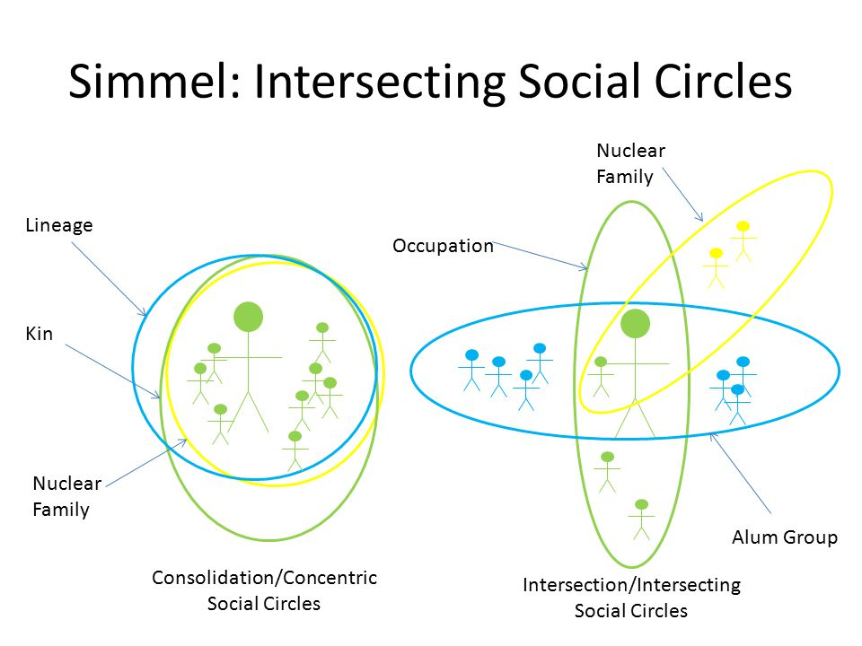
The Crosscutting of Social Circles

Slide 12
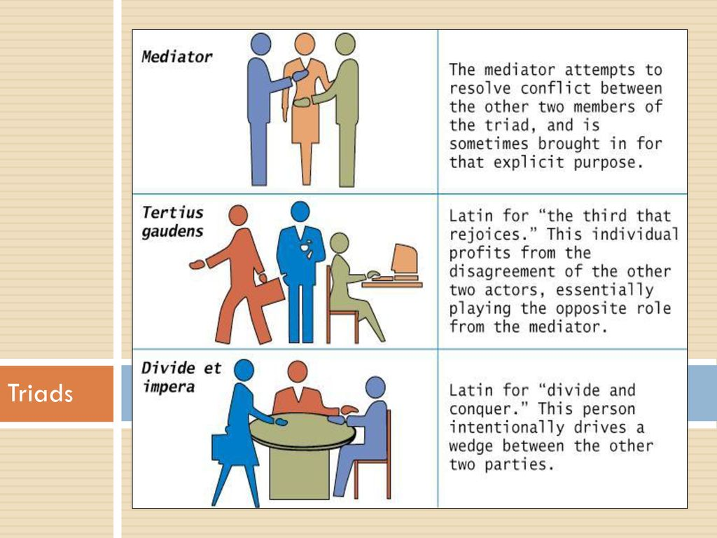
Simmel’s Contributions

Slide 13
Social Capital

Slide 14
Blat

Slide 15
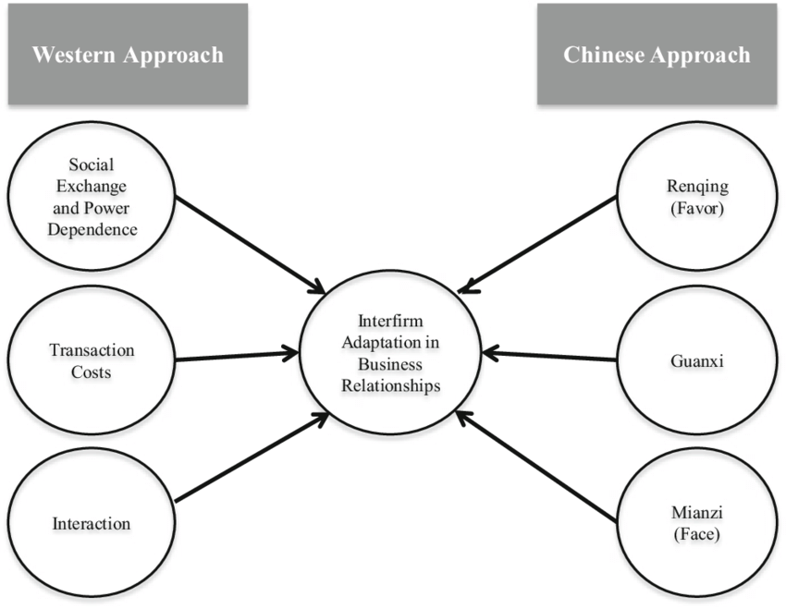
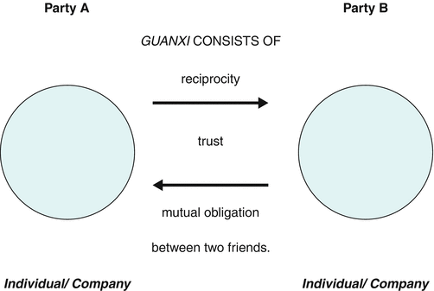
Guanxi

Slide 16
Guanxi vs. Blat

Slide 17
Authority and Legitimacy

Slide 18
Boltanski’s Justification

Slide 19
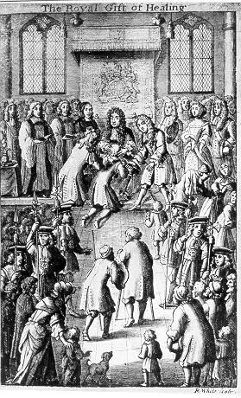
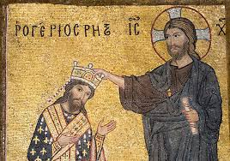
From Legitimacy to Models of Authority
Rhetorical Devices
Signs of Legitimacy
Magical Powers
Systems of Beliefs

Slide 20
The Weberian Model

Slide 21
Traditional and Charismatic

Slide 22
From Charisma to The Rational Legal
Charismatic leaders tend to hold power for short durations, and according to Weber, they are just as likely to be tyrannical as they are heroic.
For this reason, the routinization of charisma occurs when charismatic authority is succeeded by a bureaucracy controlled by a rationally established authority or by a combination of traditional and bureaucratic authority.

Slide 23
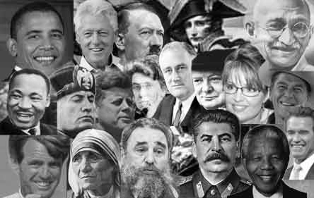
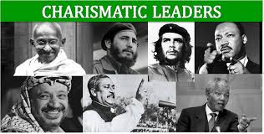
Charisma what Charisma?

Slide 24
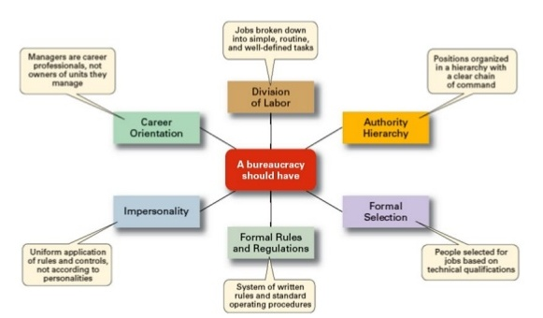
The Bureaucratic Ideal-Type

Slide 25
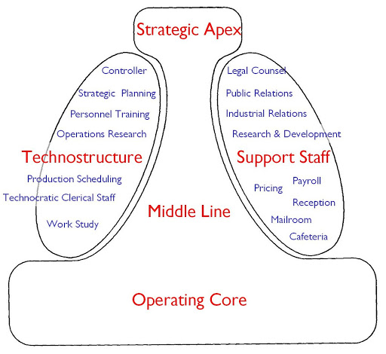
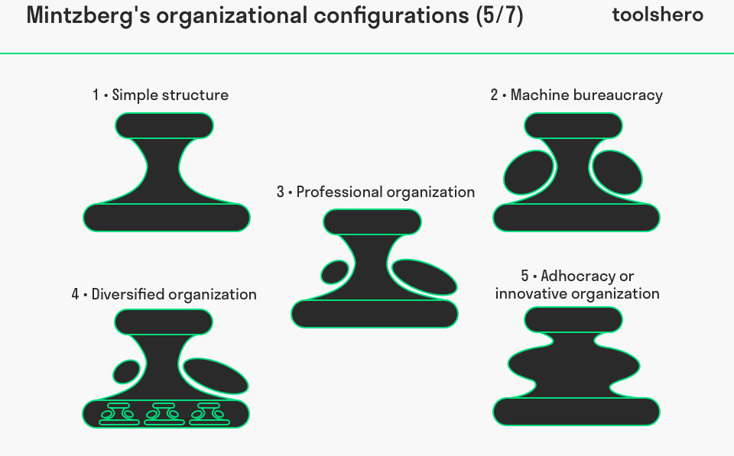
Formal Structure in Organizations

Slide 26
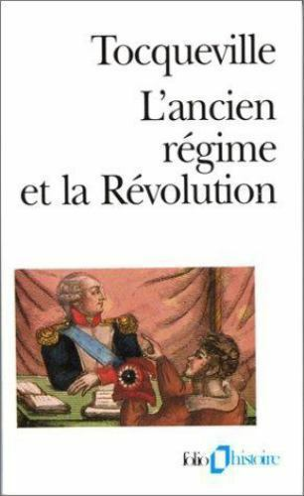

Slide 27
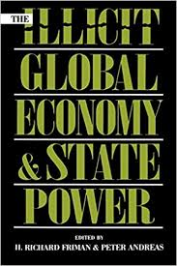
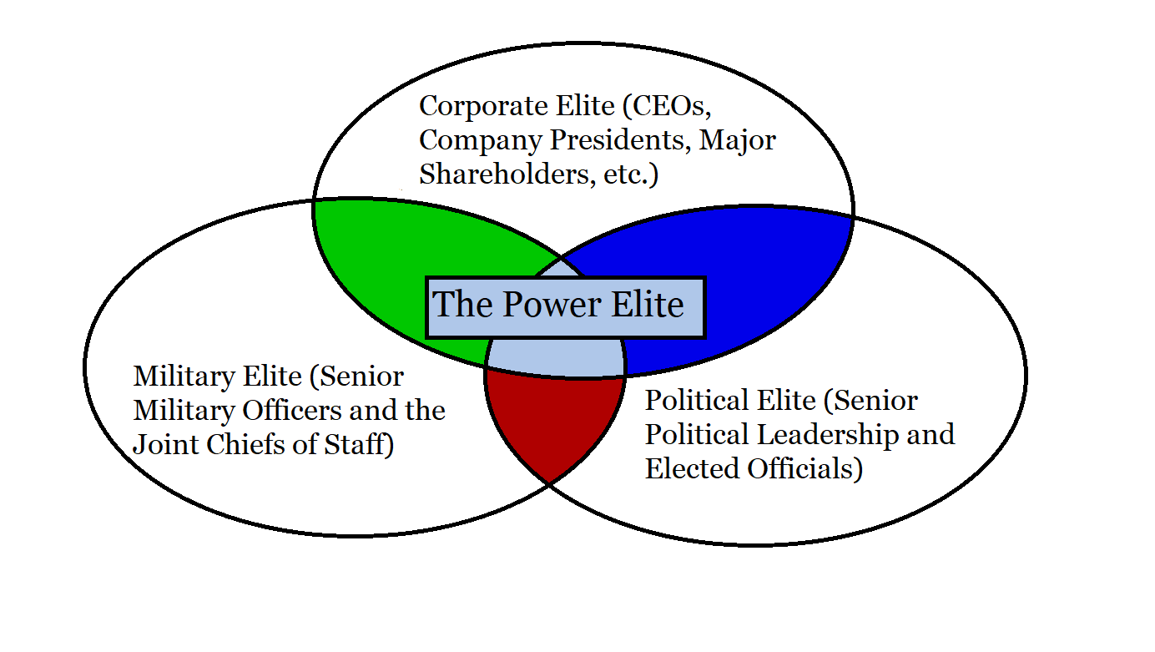
Different Powers
Professional Powers
Corporate Powers
Social Influences
State Power
Power Elites
Political Parties
Lobbies

Slide 28
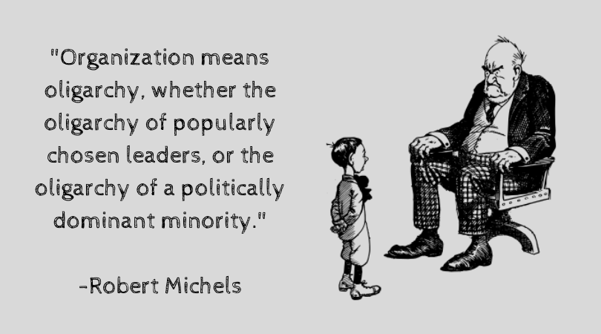
The Iron Law of Oligarchy

Slide 29
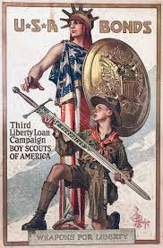
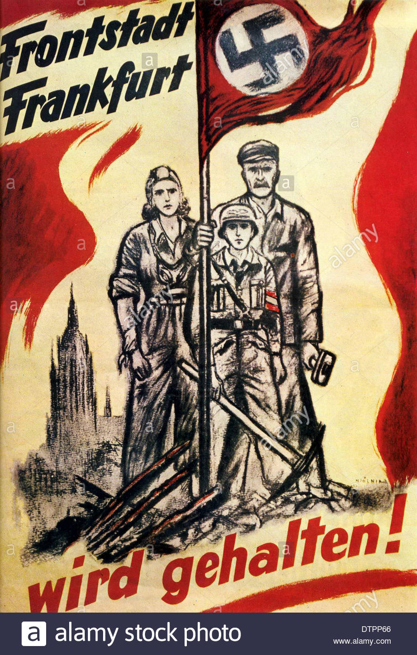
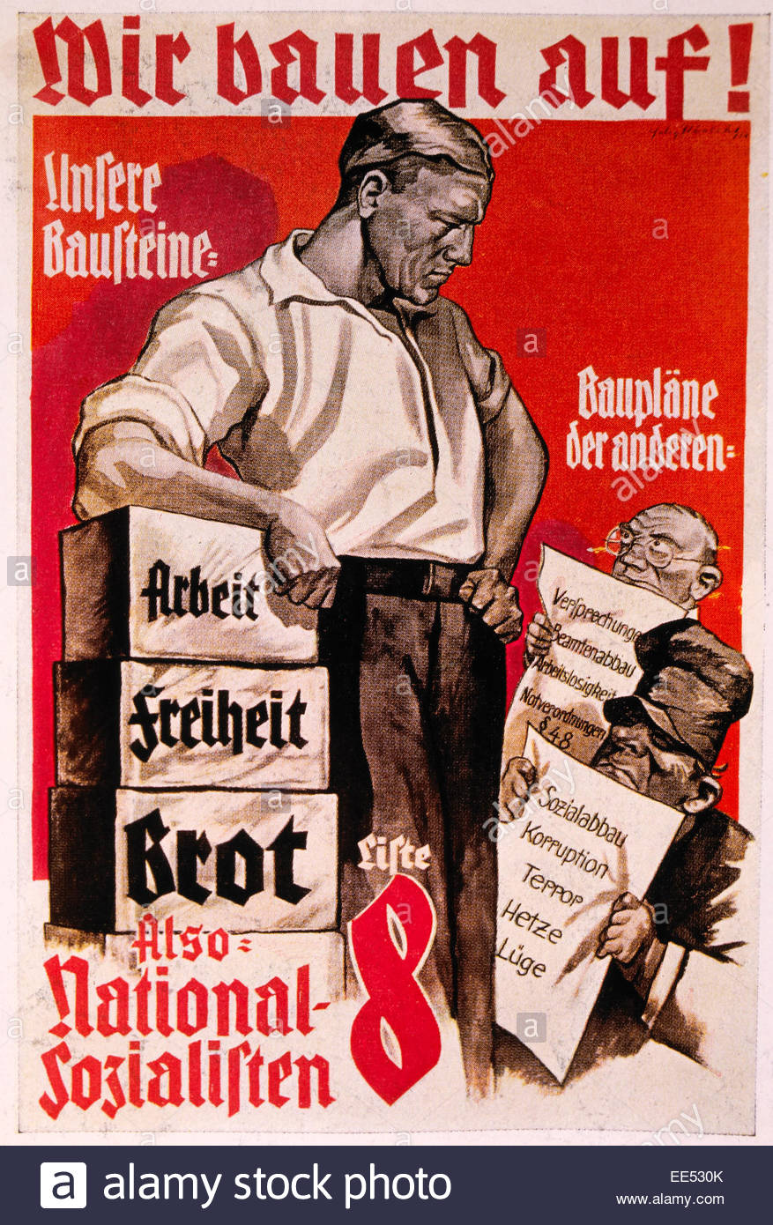
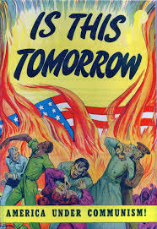
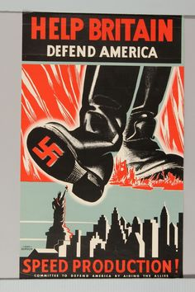
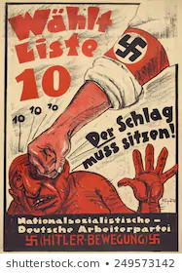
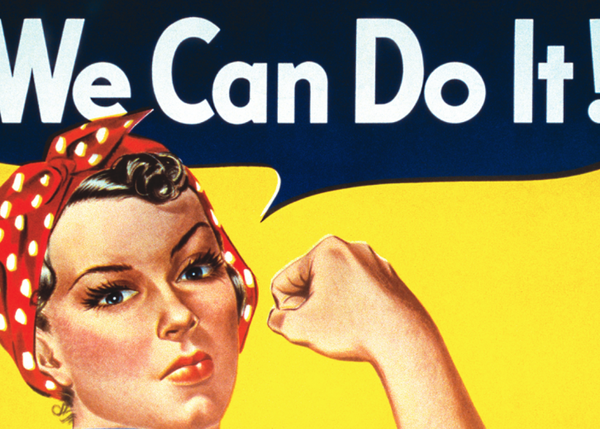
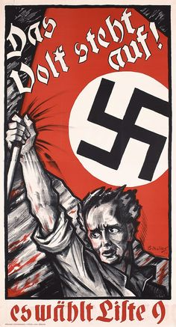
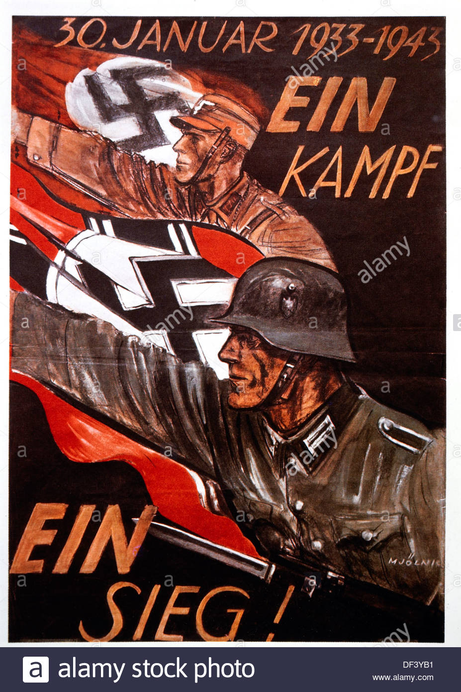
Propaganda

Slide 30
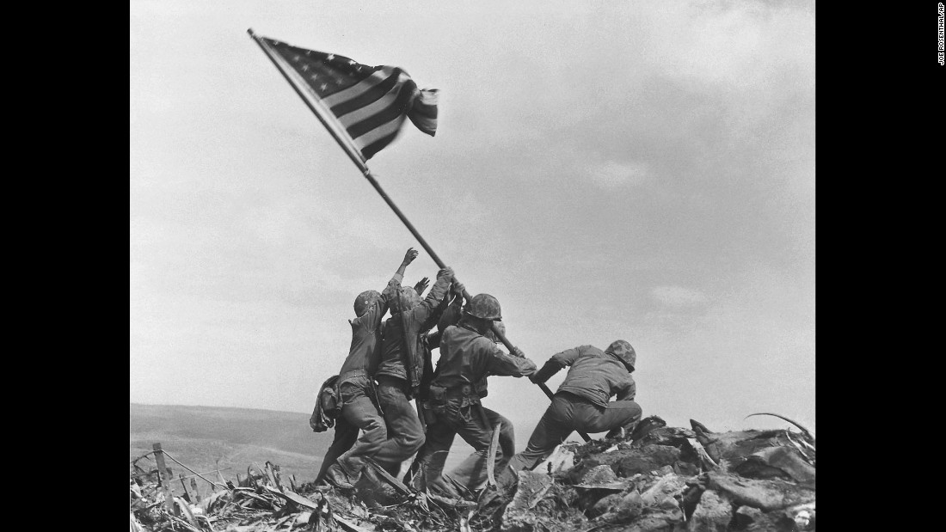
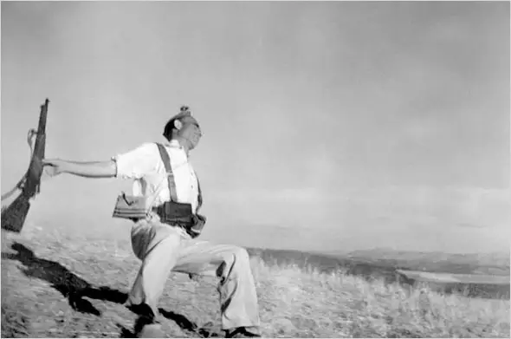
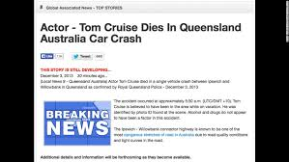
Manipulation

Slide 31
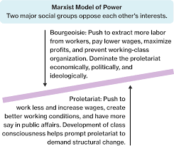
Power and Conflict at the Macro-Level
PR = SV/FC+VC
SV ?
VC ?
VC and FC

Slide 32
Marx on Power

